Slide 1
CALCULUS
CURVE SKETCHING

Slide 2
Sketch the graphs of the derivative functions for each of the functions with the graphs shown.

Slide 3
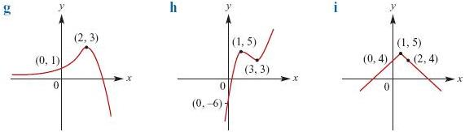

Slide 4
To sketch a derivative graph,
just work out the gradients at the major points on the original.
In particular a turning point on f(x) will always be an x intercept on f'(x) (as the gradient at a turning point is 0.)
Whenever the graph of f(x) is going down (ie the gradient of f(x) is negative), f'(x) will be negative and vica versa.

Slide 5
Also, remember that the derivative will always be one polynomial less than the original, so the derivative graph of a quartic will look like a cubic, the derivative graph of a cubic will look like a parabola, etc.

Slide 6
Once you know all that information, you should be able to sketch derivative graphs simply by looking at the original graph.

